Slide 1

Healthcare Data Analysis Project

Slide 2
Contents :-
1. Project Overview & Objective
2. Data Cleaning and Modeling
3. KPI LIST
4. Dashboard Presentation
5. Challenges Faced
6. Solutions Implemented
7. Conclusion

Slide 3

Project Overview & Objective
Project Overview
This project is based on a healthcare dataset that includes detailed information about patients, doctors, visits, treatments, and lab results.
It focuses on managing and analysing patient demographics, medical history, and contact information.
The project also examines doctor details such as specialization, experience, and hospital affiliation.
It provides insights into patient visits, including diagnosis, reasons for visits, and prescribed medications.
Additionally, the project covers treatment data like medication, dosage, cost, and outcomes.
Lab test results are also analysed to understand patient health conditions and medical reports.
Overall, this project helps in understanding how healthcare data is organized and used to improve patient care and decision-making.
Team & Timeline
.
4-week project duration, evolving through various tools:
Week 1: Excel for initial data exploration.
Week 2: Tableau for initial modeling and visualization.
Week 3: Powerbi and SQL for advanced analysis.
Week 4: Final presentation preparation.
Key Goal: Ensure consistent Key Performance Indicators (KPIs) across all analytical tools used.

Slide 4





Data Cleaning And Data Modeling
Distributed Cleaning
Rigorous Cleaning
I Am responsible for cleaning and modeling one specific dataset, ensuring thorough initial processing.
Systematic removal of duplicates and comprehensive handling of missing values across all datasets to maintain data integrity.
Seamless Integration
Standardized KPIs
All individual sheets were meticulously merged into a single, cohesive master dataset, ready for unified analysis.
Implemented a unified set of KPIs, ensuring consistency and comparability across Power BI, Tableau, and SQL environments.
This structured approach to data preparation was crucial for building a reliable foundation for our subsequent analysis and dashboard development.

Slide 5
KPI List
Total Patients = 10,000 (Total number of registered patients)
2. Total Doctors = 1000 (Total number of available doctors)
3. Total Visits = 10,000 (Number of patient visits over a given period)
4. Average Age of Patients = 49.9
5. Top 5 Diagnosed Conditions = Migraine , Hypertension , Asthma , Healthy , Diabetes
6. Treatment Cost Per Visit (Avg.) = 524.75
7. Total Lab Tests Conducted = 10,000 (Volume of lab tests performed)
8. Percentage of Abnormal Lab Results = 34 % (The rate of abnormal test results)
9. Doctor Workload (Avg. Patients Per Doctor) = 10

Slide 6
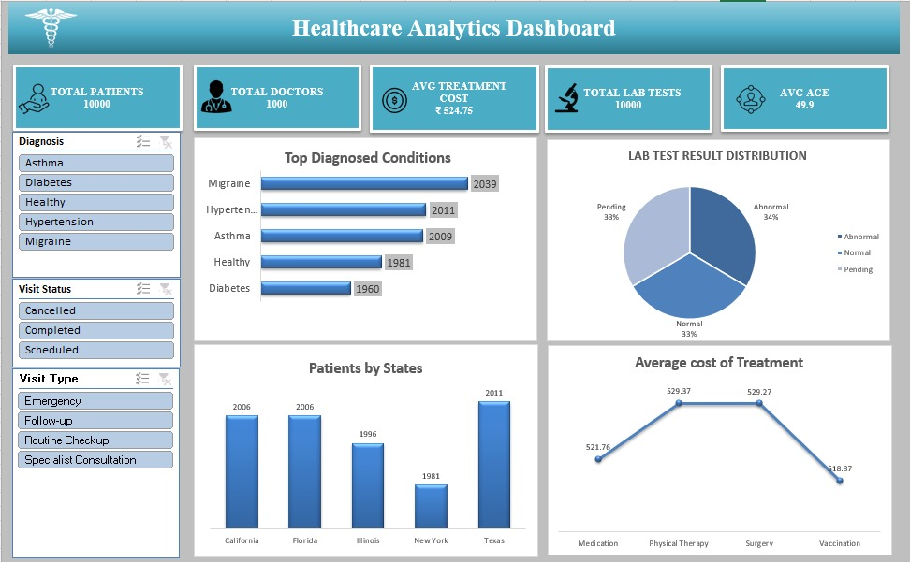
Excel Dashboard

Slide 7
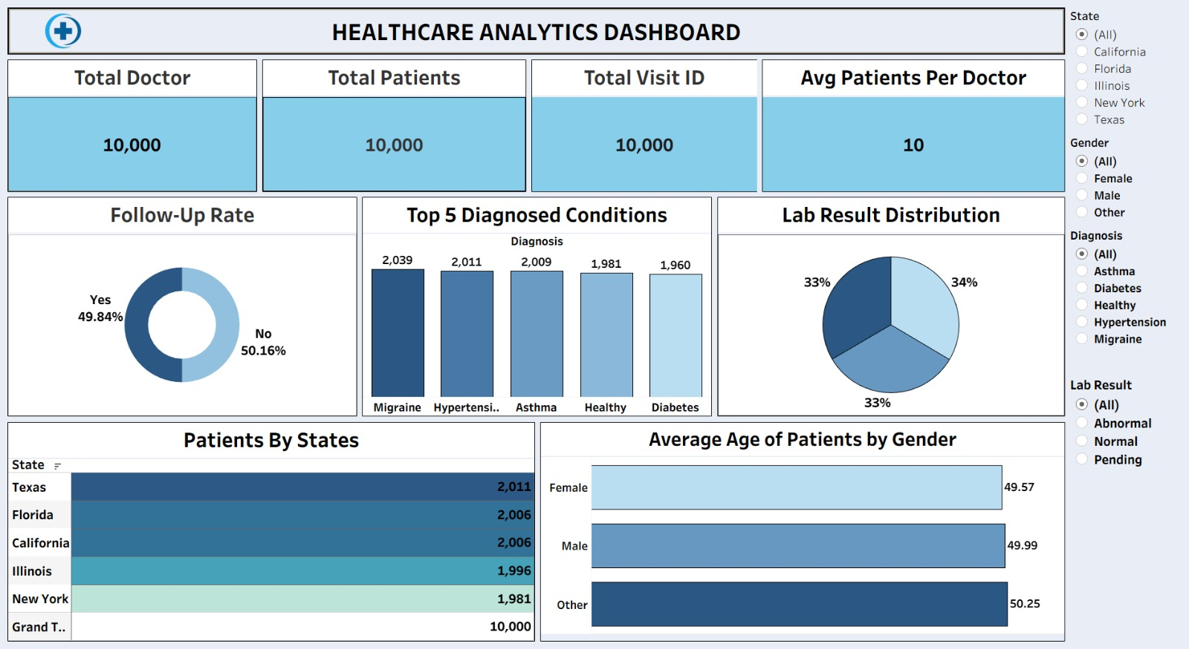
Tableau Dashboard

Slide 8
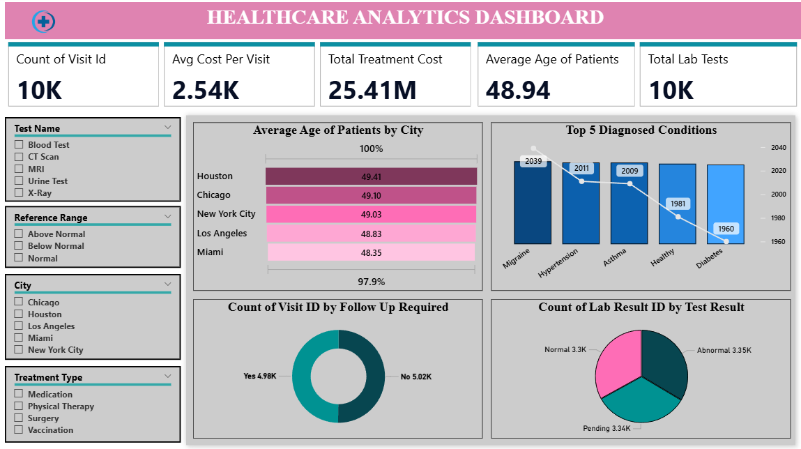
Power BI Dashboard

Slide 9
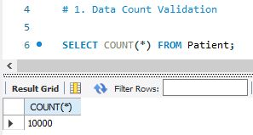
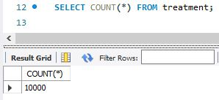
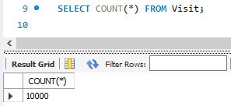
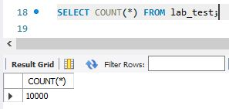
MySQL Queries

Slide 10
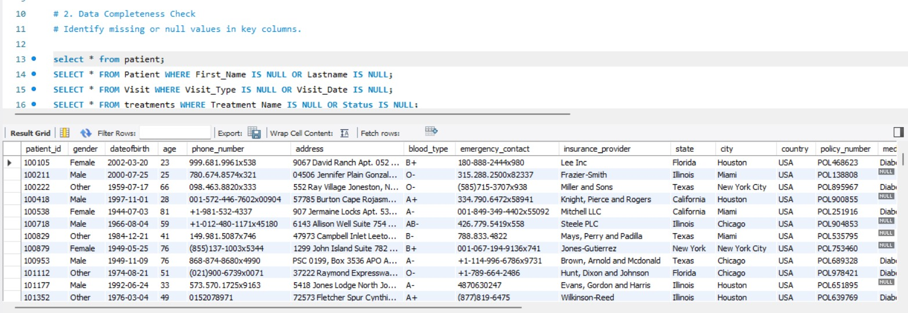
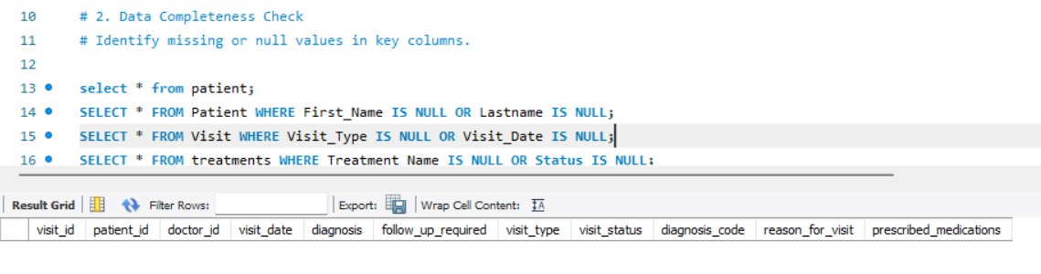
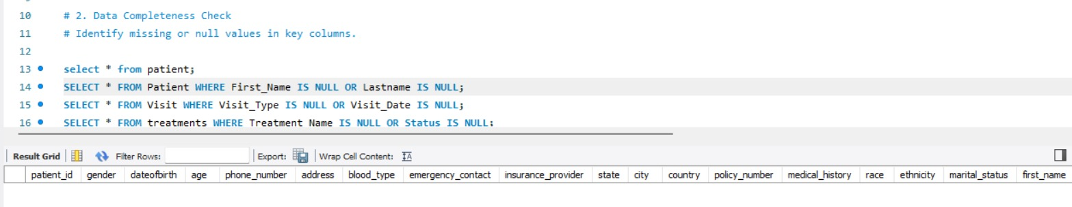
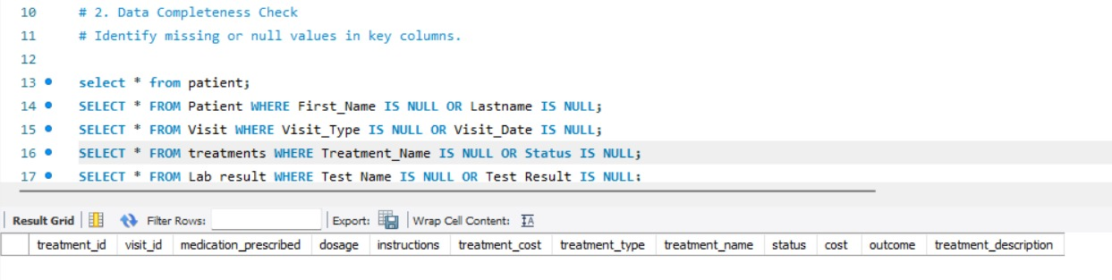

Slide 11
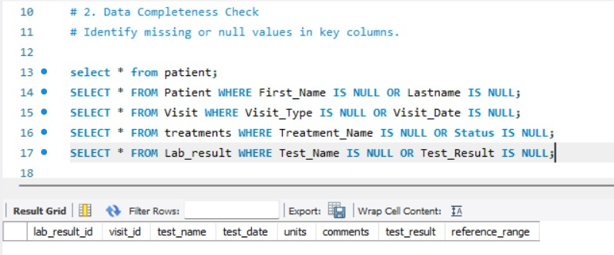
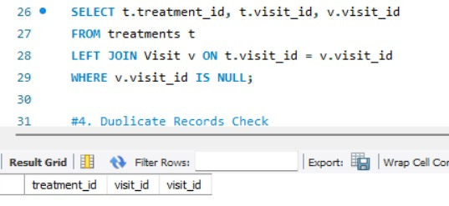
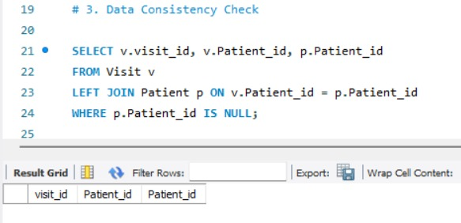
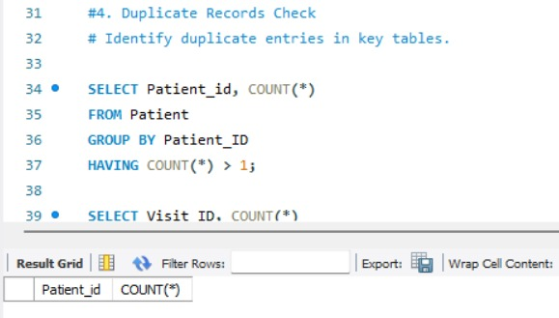

Slide 12
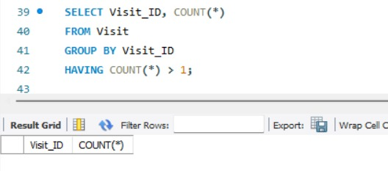
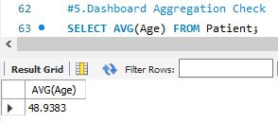
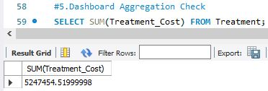
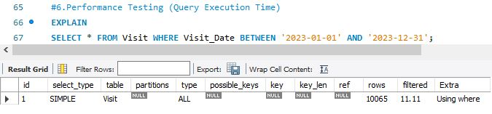

Slide 13

Challenges Faced & Solutions
Challenges Faced
Managing large volumes of healthcare data from multiple sources was complex.
Ensuring data accuracy and consistency across different tables (patients, doctors, visits, etc.) was difficult.
Handling relationships between entities like patients, doctors, and treatments required proper structuring.
Missing or incomplete data in records created issues during analysis.
Maintaining data privacy and security was a major concern.
Understanding real-world healthcare workflows and mapping them into a database was challenging.
Solutions Implemented
Organized the data into structured tables such as Patient, Doctor, Visit, Treatment, and Lab Results.
Used proper database design techniques (like primary keys and foreign keys) to maintain relationships.
Cleaned and validated data to handle missing or incorrect values.
Ensured data consistency by standardizing formats and entries.
Applied logical design to accurately represent real-world healthcare processes.
Focused on secure handling of sensitive healthcare information.

Slide 14
Conclusion
The project demonstrates how healthcare data can be efficiently organized and managed.
It highlights the importance of accurate data in improving patient care.
The analysis helps in understanding treatment patterns and medical outcomes.
Proper data management can reduce errors and improve hospital efficiency.
Overall, this system supports better decision-making in healthcare services.

Slide 15
THANK YOU

